Slide 1

ZOMATO RESTAURANTS EXPANSION
Decision Making for Restaurant Expansion
By
Meganathan Ramalingam
Batch Jan 2025

Slide 2
INTRODUCTION TO ZOMATO
History
Zomato was founded in 2008 as a restaurant discovery platform in India. It started as a website that provided information about restaurants, including menus, reviews, and ratings.
Mission
Zomato's mission is to ensure that everyone can find and enjoy great food. They aim to connect users with the best dining experiences by providing accurate and comprehensive information about restaurants.
User Base
Zomato has a large and diverse user base, with millions of active users worldwide. It is available in multiple countries and supports multiple languages, making it accessible to a global audience.

Slide 3
Project Aim
Business Problem -> To identify optimal countries and cities for opening new restaurants to expand our business. We need to find cities and countries with high potential based on several criteria, including customer preferences, cost efficiency, and competition analysis.
Objective -> Leverage data analytics to uncover insights that guide our decision-making for choosing the most promising locationsby analysing existing restaurant performance, market demand, and economic factors, ensuring profitable and strategic expansion.

Slide 4
Data Overview
Restaurant ID: Unique identifier for each restaurant.
Restaurant Name: The name of the restaurant.
CountryCode: Country code of the location where the restaurant is situated.
Country: The country of restaurant located.
City: The city where the restaurant is located.
Address: The specific address of the restaurant.
Locality: The locality or neighborhood where the restaurant is situated.
Locality Verbose: Detailed information about the locality.
Longitude: The geographical longitude coordinate of the restaurant.
Latitude: The geographical latitude coordinate of the restaurant.
Currency: The currency used for transactions in the restaurant.
Price: The cost of two people dining with respective currency symbol.
Years: The year of restaurant opened.
Has_Table_booking: Indicates whether the restaurant has a table booking option (Yes/No).
Has_Online_delivery: Indicates whether the restaurant offers online delivery (Yes/No).
Is_delivering_now: Indicates whether the restaurant is currently delivering (Yes/No).
Switch_to_order_menu: Indicates whether users can switch to the order menu (Yes/No).
Price_range: A numeric value indicating the price range category of the restaurant.
Votes: The number of votes or ratings/(feedback) received by the restaurant.
Average_Cost_for_two: The average cost for two people dining at the restaurant.
INR_Average_Cost_for_two: The average cost for two people dining at the restaurant in INR.
Rating: The overall rating of the restaurant is based on user reviews.
Updated_Datekey_opening: The date when the restaurant was opened.

Slide 5

Data Cleaning
Treated the missing values in the 'Cuisines' column for the USA.
Treated the missing values in the ' Longitude & Latitude ' column
Standardized the date to a uniformed format.
Processed various currencies and converted them into INR for better comparison.
Created new columns for year, quarter from the date for better visualization.
Merged the respective currency with its associated cost using string operations.
Used LOOKUP functions to fetch the appropriate country codes.

Slide 6
Implementation
Missing value treatment:- Used pivot table, Sorting in Descending order, ISBLANK function, IF function, Average of city wise and applied and took Median, Mode, Mean and applied to missing values respectively.
Data Enrichment:- For better analyzation implemented additional column which helped in better categorization of data and used LOOKUP,XLOOKUP, MID, SEARCH, CONCATENATE, TEXT, DATEVALUE, SUBSTITUTE, YEAR, MONTH,GET PIVOTDATA and connecting tables to cross reference with original data source.
Descriptive Analysis:- Employed Pivot tables for summarizing key metrices, conditional aggregational functions and normal excel functions (count, if, etc.) for analyzing objective questions.
Executive Segmentations:- Applied country and year wise slicers to analyse the various outcomes of used engagements, ratings, prices etc. for different countries at a different timeline.
Data Visualization:- Created dynamic charts and Dashboard for data representation, enabling interactive data exploration.

Slide 7

Key Statistics of Zomato Data
Total Number of Restaurants: 9,551 restaurants from various countries around the world.
Total Number of Cuisines: 1,825 cuisines from various restaurants across different countries and states.
Total Number of Cities: 141 cities have been analysed from 15 countries.
Total Number of Votes: 1,498,645 votes were cast in the review system to generate feedback.

Slide 8
Year wise Restaurant Openings
The number of restaurants from 2010 to 2018 shows a generally positive trend with some fluctuations, indicates growth in the sector.
The highest number of restaurants opened in the year 2018, followed by 2011 and 2017.
After 2011, there was a drop in the number of openings, followed by another drop in 2015, after which the number began to rise consistently.

Slide 9
Country Wise Restaurant Opening
India leads the market with 8,652 restaurants, accounting for ~90.6% of the total.
Mature markets like the U.S. (434) and U.K. (80) show established competition.
Emerging markets such as Brazil, South Africa, and UAE (60 each) offer growth potential.
Smaller markets like New Zealand, Turkey, and Australia present limited but valuable expansion opportunities.
Underdeveloped markets like the Philippines, Indonesia, and Sri Lanka have low competition, making them attractive for new ventures.
Untapped markets like Canada (4) offer high potential but come with greater risks

Slide 10
Country Wise Rating
India has the lowest average rating (2.8), indicating potential service quality issues.
Philippines (4.5), Turkey (4.3), and Indonesia (4.3) lead in customer satisfaction with the highest ratings.
UAE (4.2), New Zealand (4.3), and South Africa (4.21) also show high customer satisfaction.
Moderate ratings in Canada, Singapore, and Australia (around 3.6) suggest room for improvement.
High-rated markets present opportunities for expansion, leveraging strong customer perceptions.

Slide 11
Country Wise Average Cost of Two
Singapore, the Philippines, and the United Kingdom have significantly higher expenditure management costs, making them more challenging for budget control.
In contrast, Sri Lanka, Turkey, India, Indonesia, and South Africa have much lower expenditure management costs. For our filtered countries, with an average expenditure below 30, we can effectively manage and control our budget.

Slide 12
Country Wise Average Voters
Indonesia is having the highest number of voters in restaurants, followed by UAE, USA AND Philippines.
Brazil has a lowest number of voters in restaurants, followed by Singapore.
As compare to number of restaurants in India, the number of voters are very less.

Slide 13
Online Delivery and Table Booking
Out of the total records, 2,451 entries (around 26%) offer an online booking option, with limited support across countries.
Implementing or enhancing online delivery services tends to result in higher ratings, indicating positive customer response to this feature.
Notably, in the United Arab Emirates, 47% of the entries (28 records) support online delivery, which correlates with good ratings.
Among the records, 1,158 entries (12%) offer a table booking option, with limited adoption across countries.
Similar to online delivery, providing table booking services is associated with higher ratings, reflecting positive customer feedback.
Countries like Qatar, the United Arab Emirates, and South Africa have notable support for table booking, contributing to their strong ratings.

Slide 14
Distribution of Restaurant VS Price Ranges
Price range 1 has the largest share with 4,444 restaurants, making it the most common price point.
Price range 2 has a significant presence with 3,113 restaurants, indicating a notable portion of the market.
Price range 3 includes 1,408 restaurants, showing a moderate representation.
Price range 4, the least frequent, has 586 restaurants, reflecting a smaller, premium segment.
Overall, there is a strong concentration in lower price ranges, highlighting affordability as a key market factor.

Slide 15
Country Wise Average Price Range
India has the lowest average price range at 1.72, indicating generally lower dining costs.
Qatar, Singapore, and South Africa have the highest price ranges, reflecting more expensive dining experiences.
Brazil, Philippines, and New Zealand also show higher-than-average dining costs.
United States, Australia, and Canada offer more affordable dining options with moderate price ranges.
Turkey, Indonesia, and UAE fall in the middle range, presenting balanced dining costs across these markets.

Slide 16
Suggested Cities
Analysed Raw Data and pivots, and suggested few cities that meets certain categories in the respective countries,
Selection Criteria:
Customer engagement is key factors for restaurant so considered restaurants with 300 and above voter.
Quality is key factor for customer engagement so considered restaurants with average rating 4.2 and above.
Price is key another factor for profit margins so considered restaurants with average price range 2.9 and above.
Affordability is another key factor considered restaurants with pricing between 900 and 7000 INR,
Competition should be lesser , considered cities with restaurants count below#10.
Indonesia | Jakarta, Tangerang
New Zealand | Auckland
Philippines | Pasig City, San Juan City
South Africa | Inner City, Johannesburg, Randburg, Sandton
United Arab Emirates | Dubai

Slide 17
TOP 10 CUISINES
Top Cuisines in Suggested Cities
City | Suggested Cuisines
Pasig City | Filipino, Mexican, Ice Cream, Desserts, American
Tangerang | Indonesian, Sunda, Indonesian, Sunda
Randburg | Café, Contemporary, South African, European, Grill
San Juan City | Korean, Filipino
Inner City | Contemporary, Tapas, European
Johannesburg | American, International, Seafood, Continental, Ice Cream, Desserts, Beverages, South African, Grill
Jakarta | Western, Indonesian, Japanese, Cafe, Sunda, Sushi, Asian, Italian, Bakery, Desserts, Coffee and Tea
Auckland | Cafe, Desserts, Asian, American, Kiwi, Seafood, Sushi, Ice Cream, Italian
Dubai | Indian, Burger, American, North Indian, Continental, Cafe, Desserts, International
Sandton | Italian, Contemporary, Pizza, European, Grill, Desserts, South African

Slide 18
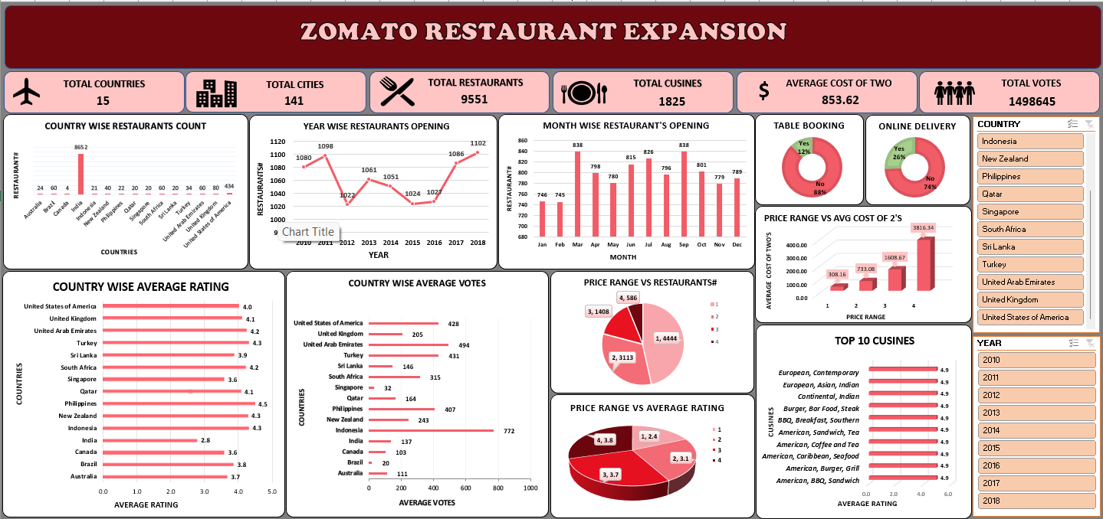
DASHBOARD

Slide 19
CONCLUSION
In conclusion, our analysis of Zomato restaurant data reveals promising opportunities for strategic expansion across the globe. By targeting regions with high demand, catering to specific demographic preferences, and capitalizing on competitive advantages, we can confidently recommend the opening of new restaurants. This initiative not only enhances market presence but also delivers exceptional dining experiences, driving sustainable growth for Zomato and enriching the global culinary landscape.

